Slide 1
Where do we go from here? ICWA after Haaland v. Brackeen
Sheldon Spotted Elk, JD

Slide 2
Culturally Relevant Design
Family Justice
Values
Approach
Process/Design
Work force

Slide 3
Thought Exercise:
What does family wellbeing mean in your Tribe?
What are the Tribal values that we show up with for families when they are struggling or failing?

Slide 4
Gold standard of child welfare
Community /Culture
Relatives
Families
Active efforts to keep children safely with their families or to reunify them with their families.
Placement Preferences to keep them connected to identity and culture.
All within a community context (Transfer).

Slide 5
Restorative Justice social discipline window
High CONTROL | TO Punitive | WITH Restorative Practice
Low CONTROL | NOT Neglectful | FOR Permissive
 | Low SUPPORT | High SUPPORT
Paul McCold and Ted Wachtel, https://www.iirp.edu/defining-restorative/social-discipline-window

Slide 6
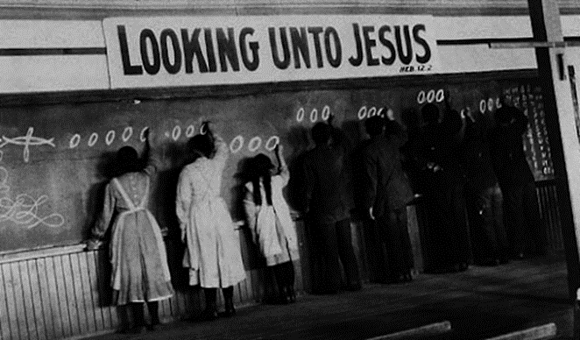
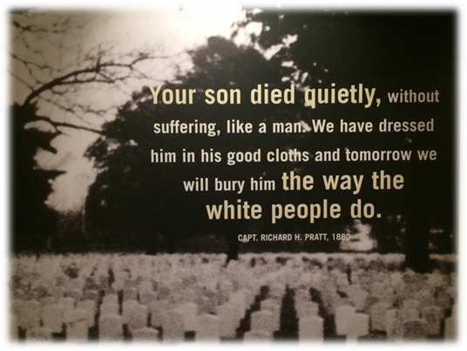
Attack on the Indian Family
Indian Civilization Act of 1819
Treaty relationship connected to Indian families
(see: Indian Children and the Federal Trust Relationship, Fletcher & Singel)
Indian Boarding Schools (523)
Termination Era (1950s)
Indian Adoption Project

Slide 7
ICWA Legal Responsibilities
Identification of “Indian Child(ren)”
Proper exercise of jurisdiction
Proper notice of proceedings
“Active efforts” to preserve the family
Use of QEW & proper standard of review
Placement preferences
Transfer to Tribal Court(s)

Slide 8
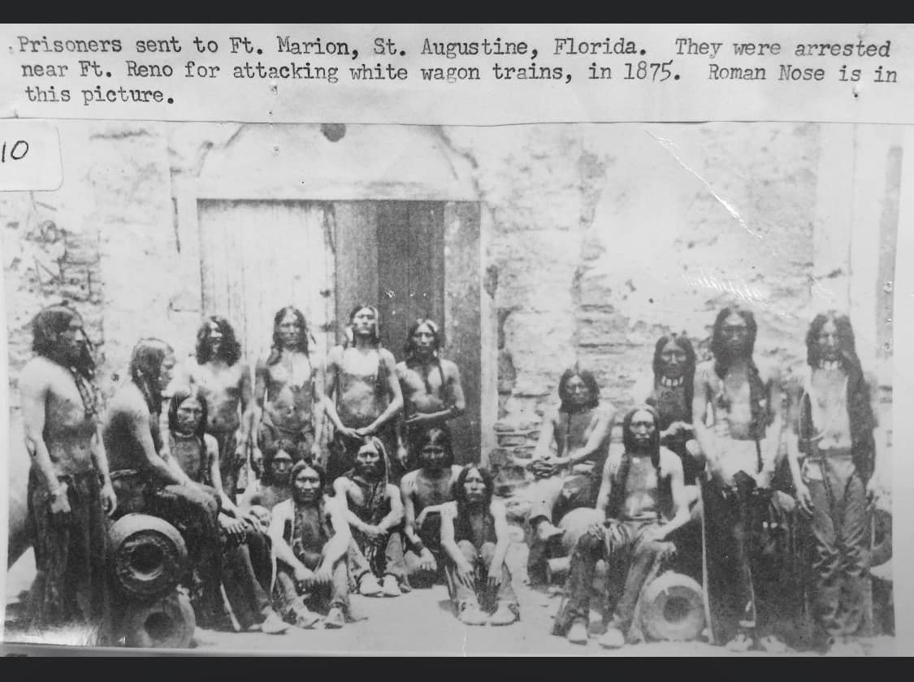
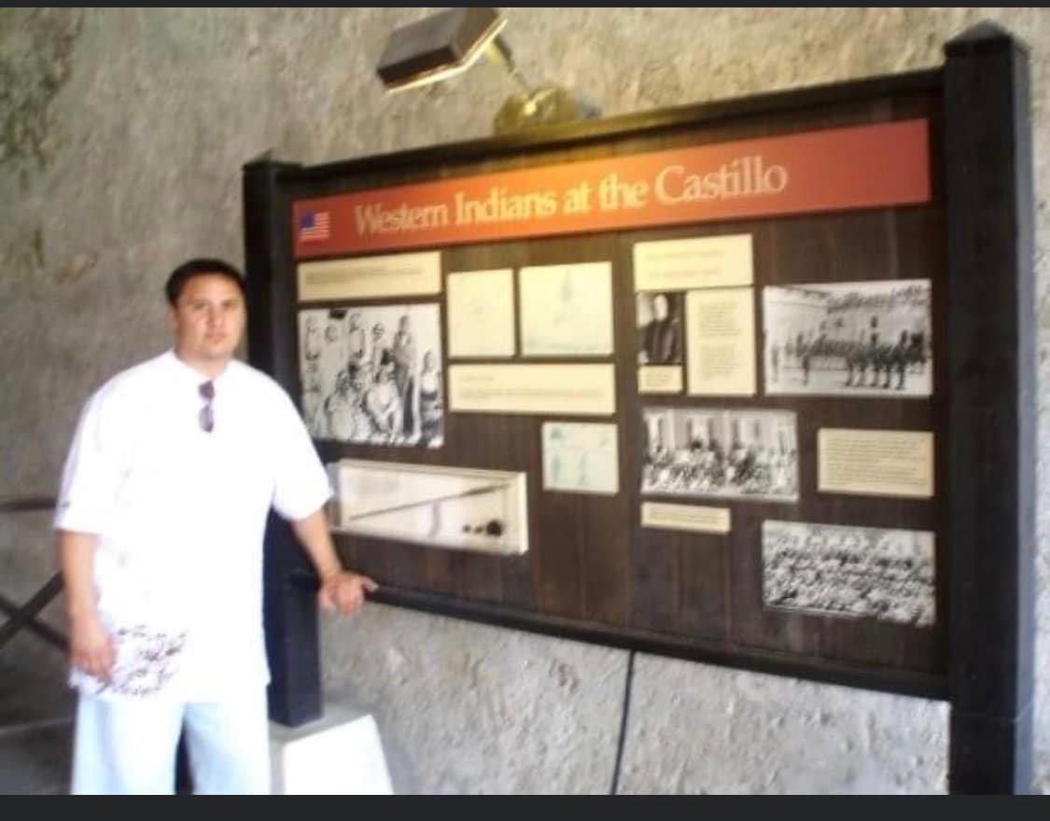
“Kill the Indian, Save the Man”

Slide 9
What does Haaland v. Brackeen hold? Summary
In this 7-2 opinion (Alito and Thomas dissent) the Supreme Court rejected all the challengers' arguments, and:
ICWA is deemed consistent with Congress’ Constitutional Authority under Article 1.
Claims that ICWA’s active efforts requirement (§ 1912(d)) and placement preferences (§ 1915) violated the principles of anti-commandeering are rejected on the merits.
No party before the Court had standing to raise equal protection challenges to ICWA’s placement preferences (§ 1915)

Slide 10
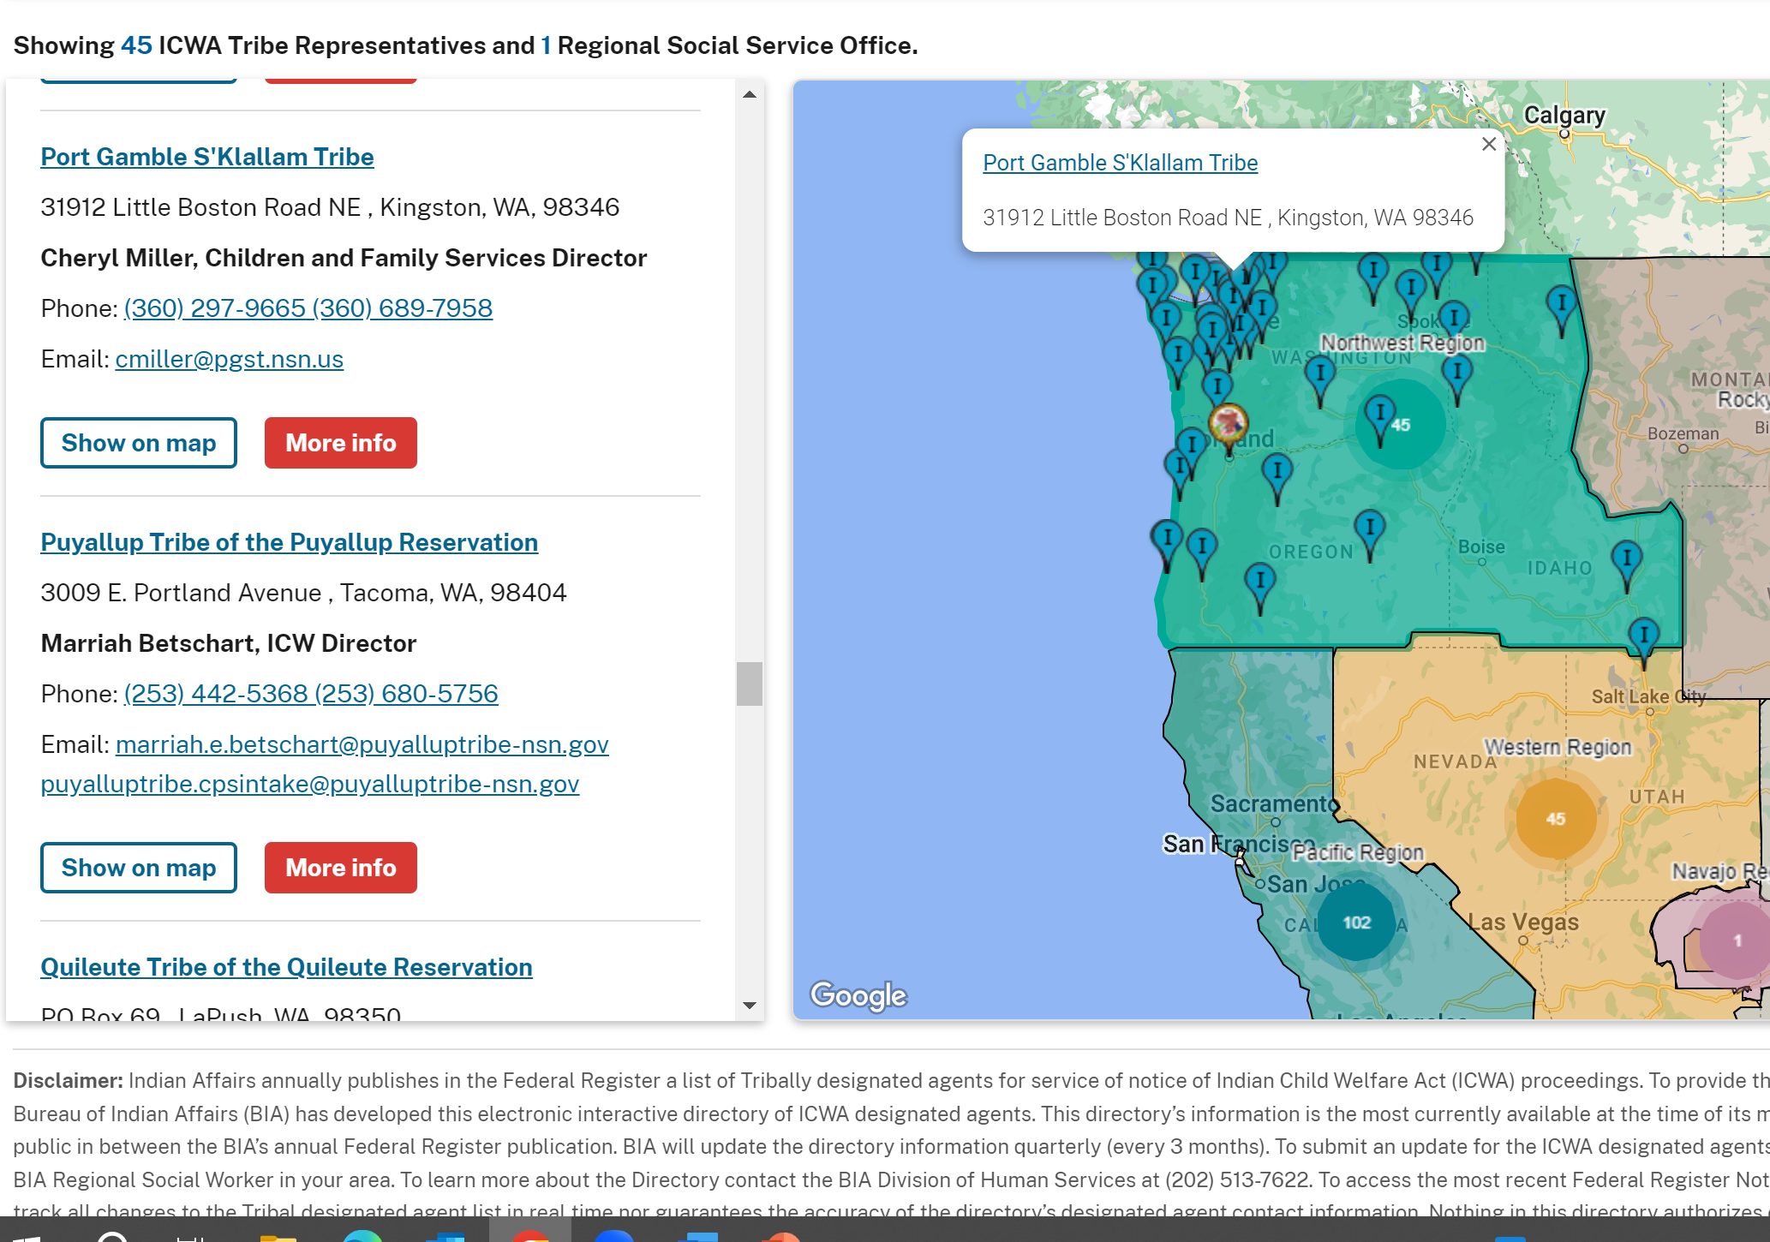
Tribal ICWA Rights: Indian Child, Notice, Intervention
Considerations:
Who is an “Indian child” for your Tribe? How is “membership” defined?
BIA Notice Agent update
Urgency: How fast can “Indian child” determination be made?
(I.e. Opening the certified mail by notice agent, communication with enrollment for verification)
https://www.bia.gov/bia/ois/dhs/icwa/agents-listing/

Slide 11
How are decisions made about transfer - intervening – monitoring?
Possible considerations:
* Tribal service array? (e.g. autism services/support or residential treatment)
* Family Finding?
(i.e. Placement Preferences only 30% of Tribal codes specify)
* Distance from Tribe?
* Resources?

Slide 12
Tribal Child Dependency Types of Jurisdiction
 | Child Protection Services (CPS) | Court Adjudication | Case Management
574 Tribal Nations | TRIBAL CPS/ Tribal Police (P.L. 638) | Tribal Courts (~ 400 Tribal Courts) | Tribal Social Services/Family Services
State Government | State CPS / State Police (P.L. 280) (e.g. Tribal-State MOUs, sec. 1919, Title IV-E “pass-thru”) | State Courts (ICWA cases) | State DCFS (ICWA Cases) Co-manage with Tribal worker
Federal Government | BIA Social Services/BIA Police Enforcement | CFR Courts (Southern Plains (6 tribes), Western Region (2 Tribes), Eastern Oklahoma (5 Tribes)) ~15 Tribes | BIA Social Services

Slide 13
ICWA Rights Considerations:
§ 1919 agreements (Or IGA/MOU/MOA)
Legal Representation? Social Work?
QEW Pushback on Active Efforts finding
Family Finding?
Safety Planning (Accessing: Safety Threat (evidence); Vulnerability; & Protective Factors)

Slide 14
Legal Process Avoid unnecessary removal, overly long stays in foster care, and trauma to families.
Shelter Hearing
Adjudication
Disposition
Reunification
Review Hearing
Safety Planning: Other options Protective Supervised Services
Gold standard representation:
Cultural humility, motivation interviewing
Qualified Expert Witness: 1) serious physicial and emotional damage to the child; 2) cultural context of child rearing.
Active Efforts to finalize a permanency plan (concurrent planning)
Active Efforts to prevent removal and Placement Preferences

Slide 15
