Slide 1
Resolving Inter-Personal Conflicts in Tribal Justice Settings
Stephanie Autumn, Director
Tribal Youth Resource Center – Tribal Law and Policy Institute

Slide 2
Session Learning Objectives
Expanded knowledge of the Indigenous Model of Restorative Practices & the application within Tribal justice settings.
Innovative strategies and approaches to build relationships & community within Tribal justice settings.
Enhanced knowledge of the relational world view & the overlay within Tribal justice settings.

Slide 3
From Where We Stand …….
There is no power greater than a community discovering what it cares about.
Ask “What’s possible?” not “What’s wrong?” Keep asking.
Notice what you care about.
Assume that many others share your dreams.
Be brave enough to start a conversation that matters.
Talk to people you know.
Talk to people you don’t know.
Talk to people you never talk to.
Be intrigued by the differences you hear.
Expect to be surprised.
Treasure curiosity more than certainty.
Invite in everybody who cares to work on what’s possible.
Acknowledge that everyone is an expert about something.
Know that creative solutions come from new connections.
Remember, you don’t fear people whose story you know.
Real listening always brings people closer together.
Trust that meaningful conversations can change your world.
Rely on human goodness. Stay together.
Margaret Wheatley Turning to One Another

Slide 4
Leading with Values

Slide 5
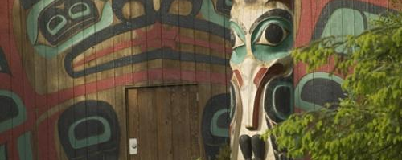
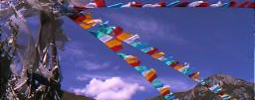
Interrelated & Interconnected
Spaces – ancient and modern.
Restorative practices can be traced to
Ancient Indigenous cultures –recurring
in various forms in many different
cultures and nations around the world.

Slide 6
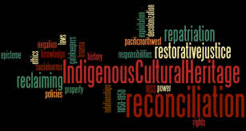
Indigenous Roots of Restorative Practices
The Indigenous Model of Restorative Practices is based on Indigenous holistic philosophy and the “Relational Worldview”. These systems are guided by the unwritten customary laws, traditions, and practices that are learned primarily by example and through the oral teachings of elders, parents, and the extended family.

Slide 7
Relational Worldview
On our globe today, there are two predominant worldview - linear and relational. The linear worldview is rooted in European and mainstream American thought. It is very temporal, and it is firmly rooted in the logic that says cause has to come before effect. In contrast, the relational worldview sees life as harmonious relationships where health is achieved by maintaining balance between the many interrelating factors in one’s circle of life.

Slide 8
The “Why” of Restorative Practices
Restorative Practices challenges us to rethink what conflict,
consequence, and harm is all about:
How can we respond to breakdowns in ways that address underlying causes? We not only want to “make right” what went wrong – but also render future harms – issues less likely.
How can we work together to make things right among us by addressing the needs of all ?

Slide 9
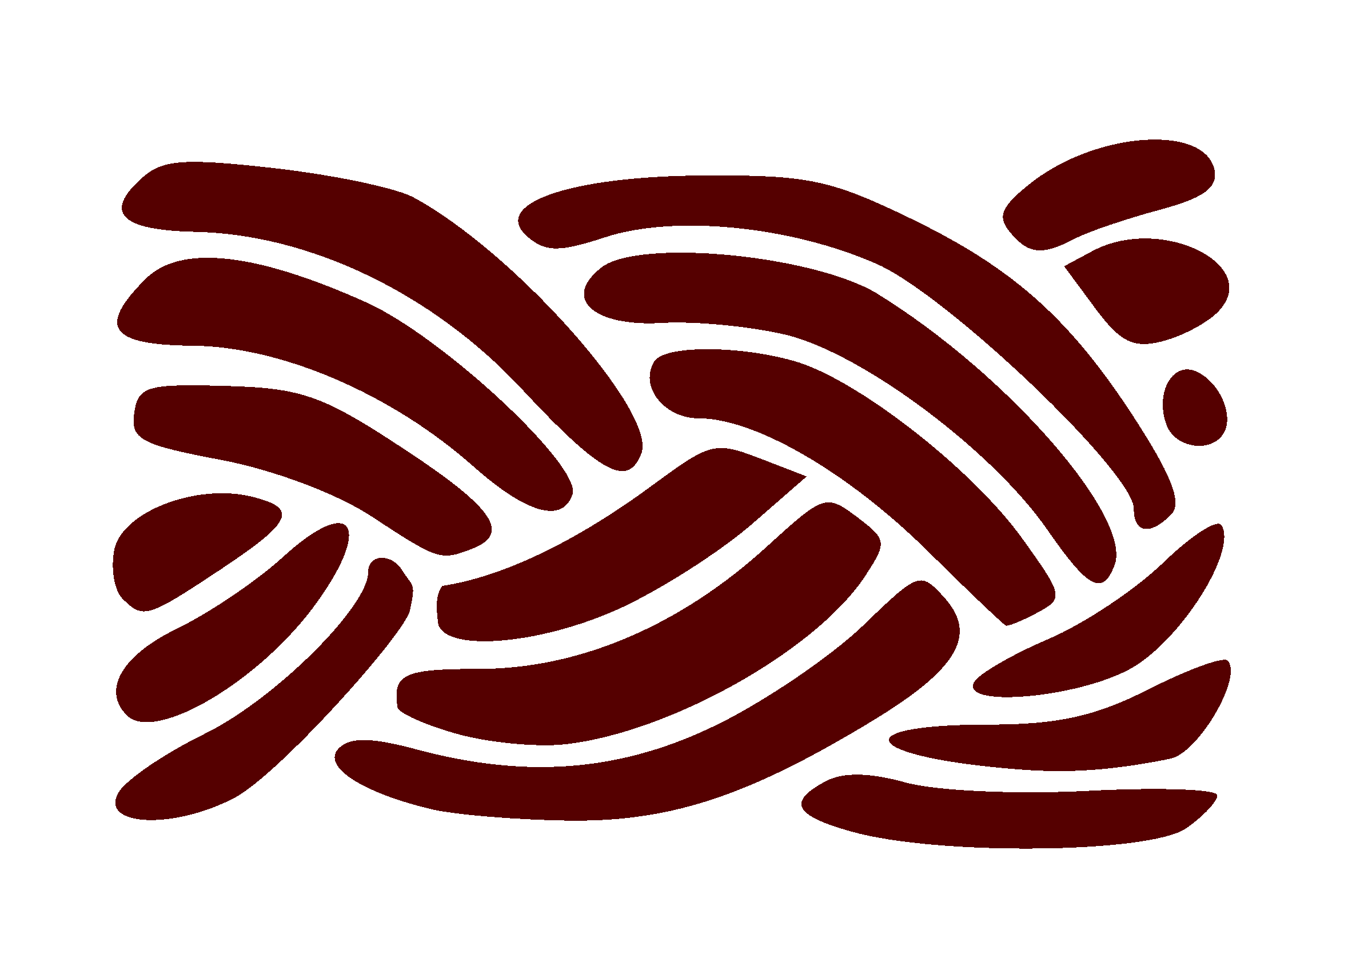
Braiding Restorative & Healing Informed Approaches into Tribal Justice Settings
Provides an empathic and compassionate space for understanding behavior.
Supports an emphasis on relationship and connection (vs. isolation and disconnection common with trauma).
Reduces likelihood of retraumatizing citizens.
Understanding trauma supports the need to adopt restorative practices.
Helps to foster an environment where restorative practices are more likely to be adopted and sustained.
Identifying and reducing trauma-related triggers can reduce potential for escalation.
Trauma knowledge can inform restorative dialogue
9

Slide 10
Creating a Space for Dialog Within Tribal Justice Settings
This hypothesis maintains
that the punitive
and authoritarian to mode
and the permissive
and paternalistic for mode
are not as effective
as the restorative,
participatory, engaging
with mode.

Slide 11
Identifying the Roots of the Harm

Slide 12
Refocusing the Lens We See Through
RESTORATIVE
NON-RESTORATIVE
Crime causes harm
The person who caused the harm should be able to be part of repairing the harm
The person(s) impacted the most by the harm, should be able to participate in the resolution
To achieve community safety, it is more important to build community peace and wellness.
Crime is law breaking
Accountability means excepting the imposed sanctions and/or punishment
The two important parties are the person who caused the harm and the Tribal justice system
To achieve community safety public safety personnel need to enforce the laws

Slide 13
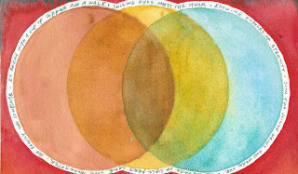
Transforming Tribal Justice Settings
Ensuring emotional and physical safety
Supporting choice, control, and empowerment
Ensuring culture and equity in the process
Using a collaborative and strengths-based approach
Viewing relationships as central to health and healing

Slide 14
A Restorative Mindset informs our daily interactions with each other and those we serve.
Positive regard for all individuals
Valuing self and others for who we are
Empathy - striving to understand the experiences of others
Self-Actualization - seeing capacity for positive growth in self and others
Optimistic perspectives on personal development – believing that people can learn and change for the better.
Accountability - acknowledging individual and community responsibility

Slide 15
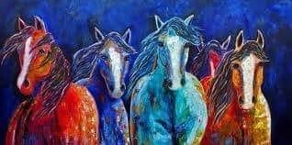
The Four Rs of Restorative Practices
Respect is the key ingredient that holds the container for all restorative practices.
Relationship is a central tenet in maintaining a healthy organization community in which there is open communication, clear expectations and ongoing growth and learning.
Responsibility: For restorative practices to be effective, personal and collective responsibility must be taken to create, care, and repair relationships.
Restore: Built on the individual capacities and strengths of the person who caused harm.
- Ask Permission
- Express Respect for the Person and Relationship
- Identify the Harm
- Identify Feelings with “I” statements
- Identify Agreements to move towards restoration

Slide 16
One Conversation at a Time
Restorative conversations can be integrated and normalized into a Tribal justice setting so that volunteers, interns, staff alike can grow their skills and capacity to integrate restorative conversations and services into professional, client, and community relationships.
CREATION
CARE
RESTORE

Slide 17
Restorative Practices Processes
Restorative Conversations
Building & Rebuilding Circles
Repairing Harm Circles
Family Group Decision Making Conferences
Community Cafés

Slide 18
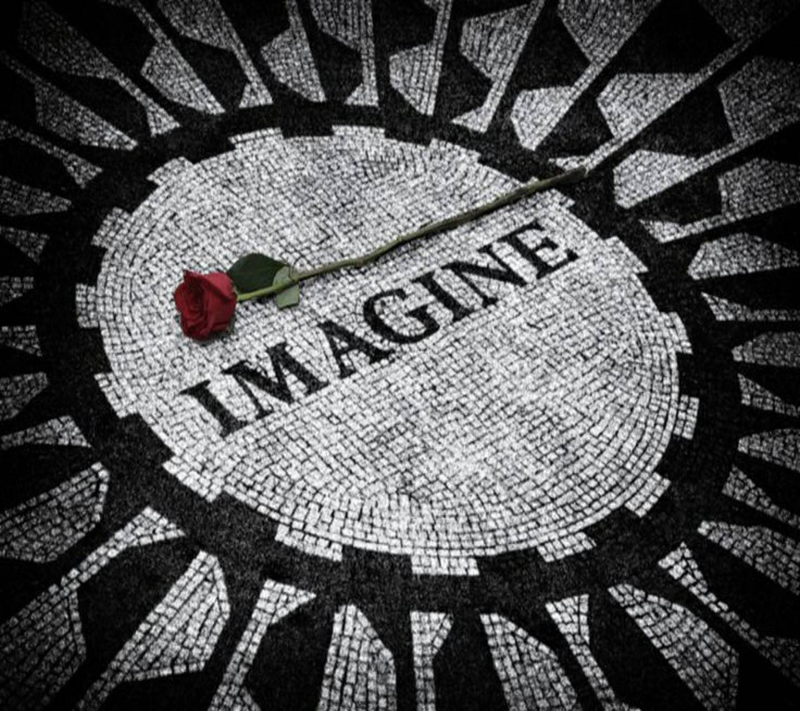
Moving Away from Adversarial Tribal Justice Settings
TIME
Environment
Policy/Language
Capacity Building
Shared Leadership
RE-Allocation of Resources
Inclusion of Those Most Impacted
Community
18

Slide 19
The Journey
Building Capacity to:
Assessing need
Identifying service gaps
Create a strategic plan for change & enhancements
Garnering internal and external supports

Slide 20
Questions & Discussion

Slide 21
Closing
Vulnerability sounds like truth and
feels like courage.
Truth and courage aren’t always comfortable, but they’re never a weakness.
Everyday we experience the uncertainty, risks, and emotional exposure that define what it means to be vulnerable or to dare greatly”
~ Brene Brown

Slide 22
Thank you
Stephanie Autumn
Stephanie@tlpi.org
www.TribalYouth.org

